Slide 1

CIGARETTE SMOKE
BEWARE! Cigarette Smoke is bad!
The smoke from cigarettes has bad chemicals that get people sick. People with allergies or asthma can be even more sensitive to smoke than others.
What Can You Do?
Don’t smoke. If you do smoke, there are many places that can help you quit. These resources are listed below:
NYS Smokers Quitline
1-866-NY-Quits
(1-866-697-8487)
American Lung Association
1-800-LUNG-USA
www.lung.org/stop-smoking
Don’t smoke in closed spaces like your home or car. This might expose others to secondhand smoke.
Smoke Irritates the lungs!
Cigarette smoke can make you cough, make your eyes water and give you a stuffy nose. Shortness of breath is also a sign of smoke irritation which can sometimes result in a wheezing sound.
Smoking doesn’t just hurt the smoker.
People who are around smoke that comes from cigaretttes (also known as secondhand smoke) have more infections that affect their breathing. They also have more asthma symptoms than those who are not around this smoke. Breathing in secondhand smoke also leads to problems with allergies, sinusitis and bronchitis.
Notes:
-Kerri Flesch-Kincaid: 4.8
Smoke Irritation is Not Pretty.
Common symptoms or signs of smoke irritation include burning or watery eyes, stuffy nose, coughing, and shortness of breath that sometimes results in a wheezing sound.
BEWARE! Cigarette Smoke is TOXIC!
The smoke from cigarettes contains many bad chemicals that get people sick. Those with allergies or other respiratory issues, such as asthma can be even more sensitive to smoke than others.
Smoking doesn’t just harm the smoker.
Those around smoke coming from cigarettes (also known as second-hand smoke) tend to have more respiratory infections and asthma than those who are not around this smoke. Breathing in second-hand smoke also leads to problems with allergies, such as sinusitis and bronchitis.

Slide 2
OUTDOOR AIR POLLUTION
What is air pollution?
Ways to protect yourself from air pollution
Sometimes the air can become dirty or polluted. This happens when harmful chemicals or small pieces of dirt get into the air.
Notice your asthma when you are exercising. Your asthma might get worse when the air is polluted. This means you may be more sensitive to air pollution. Know when and where air pollution may be bad.
Plan activities when and where pollution is lower. Exercise away from busy roads. Exercise indoors on hot, smoggy days.
Take it easy if you are active outdoors and the air is polluted.
Listen to your body. If your asthma gets worse, stop your activity and rest.
Keep your rescue or quick-relief medicine close by when you're active outdoors so you'll be prepared.
Talk to your doctor if you have questions about how and when you exercise. Ask if you should use medicine before being active.
Pollution and Asthma
Have you ever noticed asthma symptoms get worse when the air is polluted?
Air that is full of dirt and chemicals can bother your lungs and make it harder to breathe. It can make you cough, wheeze, have a tight chest and even cause a burning feeling in the lungs.
Ozone (found in smog) and particle pollution (found in haze, smoke, and dust) are two air pollutants that affect asthma.
Ozone is bad on hot, summer afternoons and evenings. Particle pollution is bad any time of year. It may be worse near busy roads and close to factories. It can also be bad where there is smoke in the air.
Sometimes you can see if the air is polluted. Most times you can't. You can find information on air quality on local TV and radio. You can also find information on the internet: www.epa.gov/airnow
Notes:
-Kerri, Flesch-Kincaid Level: 4.7

Slide 3
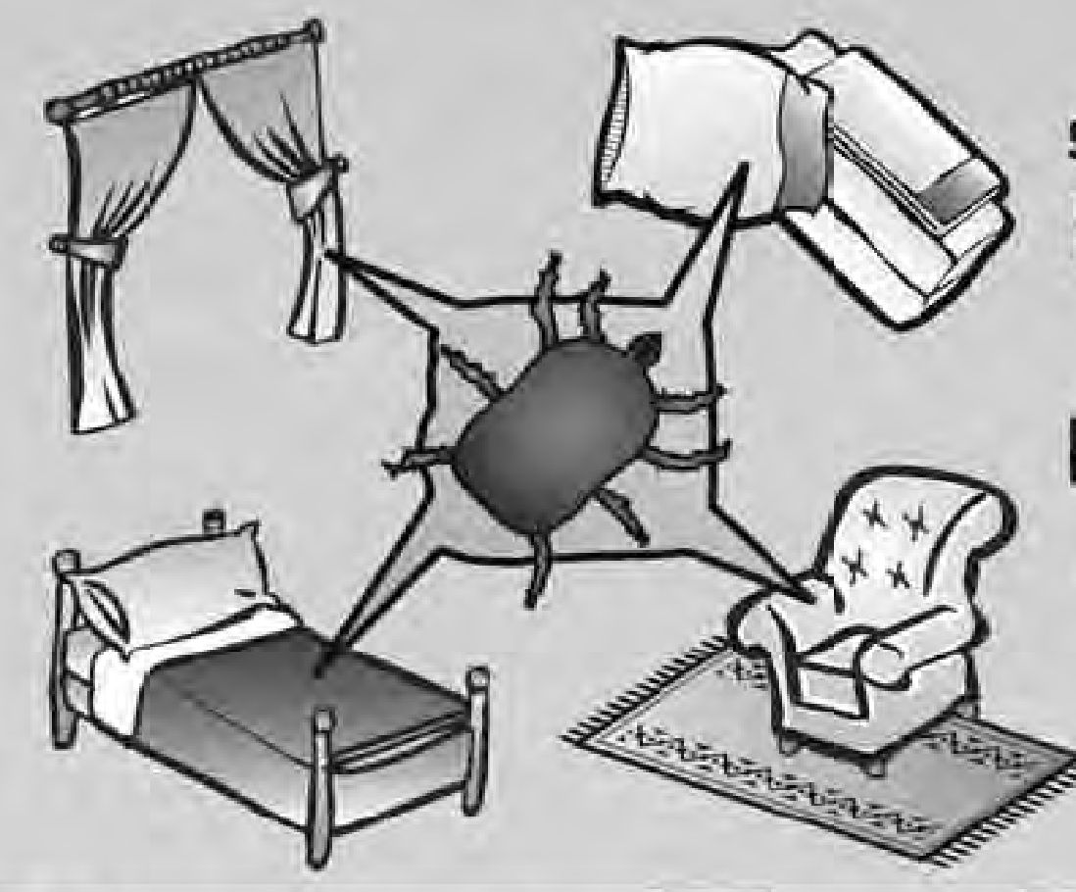
DUST MITES
Dust mites are tiny and can’t be seen with the human eye. They are small insect-like pests.
When the small particles from them are breathed in by people who are allergic to them, they can cause asthma symptoms.
Dust mites are found in everyone’s homes. They live on mattresses, sheets, carpets, curtains and couches that are made of cloth.
No matter how clean a home is, dust mites can never be totally removed. You can cut down on the dust mites in your home by following the steps below.
Ways to Control Dust Mites
Cover your mattress and pillows in allergy-proof covers. These covers don’t allow dust mites to get through. You can buy these from stores like Target, Walmart or Bed Bath & Beyond.
Wash all sheets, pillowcases and blankets once a week in hot water to kill the dust mites.
Do not use products stuffed with feathers (down comforters, coats, pillows). If you have stuffed TOYS (like Teddy bears), be sure to wash them regularly.
Change wall to wall carpets in bedrooms to bare, hard floors (tile or wood). Remove curtains, couches and chairs that are made of cloth. (Consider: blinds or shades for windows and leather or wood furniture.)
Use a wet mop or rag to wipe up dust. Never use a dry cloth because this can stir up the dust.
Use a dehumidifier (a machine that helps to take some of the water out of the air) or an air conditioner. These will help keep the amount of moisture in the air low.
Use a vacuum cleaner with a filter bag or a HEPA filter. This will help trap dust mites that get into the vacuum.
Wear a mask while you vacuum so you don’t breathe in dust mites. Stay out of the vacuumed room for 20 minutes to let the dust in the air settle after you vacuum.
Notes:
-Alexandra
Flesch-Kincaid – 4.4

Slide 4
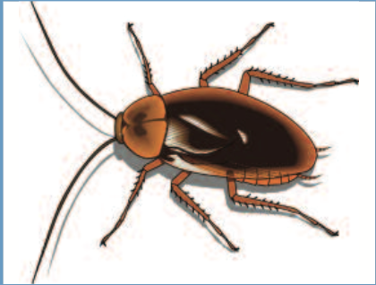
COCKROACHES
Cockroaches are common indoor pests. Studies have shown that SOME people with asthma who live with cockroaches have worse asthma symptoms. Cockroaches are more common in crowded city areas and older homes. They are found in all types of neighborhoods. The body of cockroaches, as well as their saliva and droppings can also cause asthma symptoms.
Ways to Prevent Cockroaches
Keep food out of the bedrooms.
Keep food and garbage in closed containers with lids. Never leave food out in the kitchen.
Do not leave pet food or dirty food bowls out.
Mop the kitchen floor and wash countertops at least once a week.
Fix leaky faucets and drain pipes because cockroaches like wet places.
Plug up holes around the house where cockroaches can come in.
Use bait traps and safe pesticides to remove cockroaches.
Notes:
-Alexandra
Flesch-Kincaid – 4.2

Slide 5

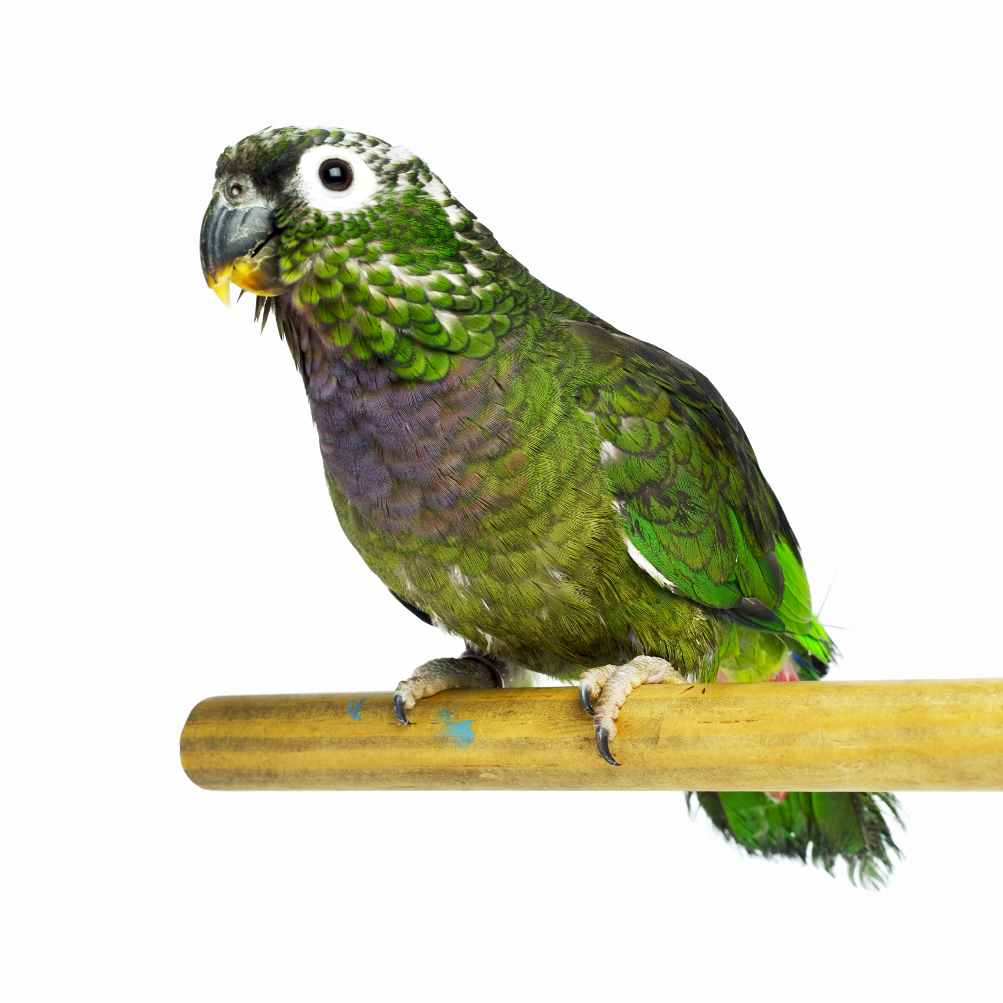
PETS & ANIMALS
Many people think animal allergies are caused by the fur or feathers of their pet. Pet dander is the cause of asthma symptoms for people with these allergies. Dander is the urine, saliva and skin flakes of furry pets.
You can have allergy symptoms with or without your pet being around. Although an animal may be out of sight, their allergens are not.
Pet allergens can move around in the air. Cat allergens can stay on carpets and furniture for weeks and months after a pet is gone.
Allergens can be carried into places on clothing and backpacks and may also be in public buildings, schools, etc., where there are no pets.
Ways to remove pet allergens
Remove pets from your home if you can.
If you cannot remove your pet, keep your pet out of places where you sleep, and off carpets or cloth-covered furniture.
Wash your pets weekly. This will get rid of some allergens.
Wear a dust mask and gloves when you are near rodents.
After playing with your pet, wash your hands and change or clean your clothes.
Stay away from dirty litter cages.
Dust often with a damp cloth.
Notes:
-Rachel
Flesch-Kincaid score = 4.7

Slide 6
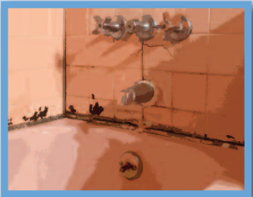
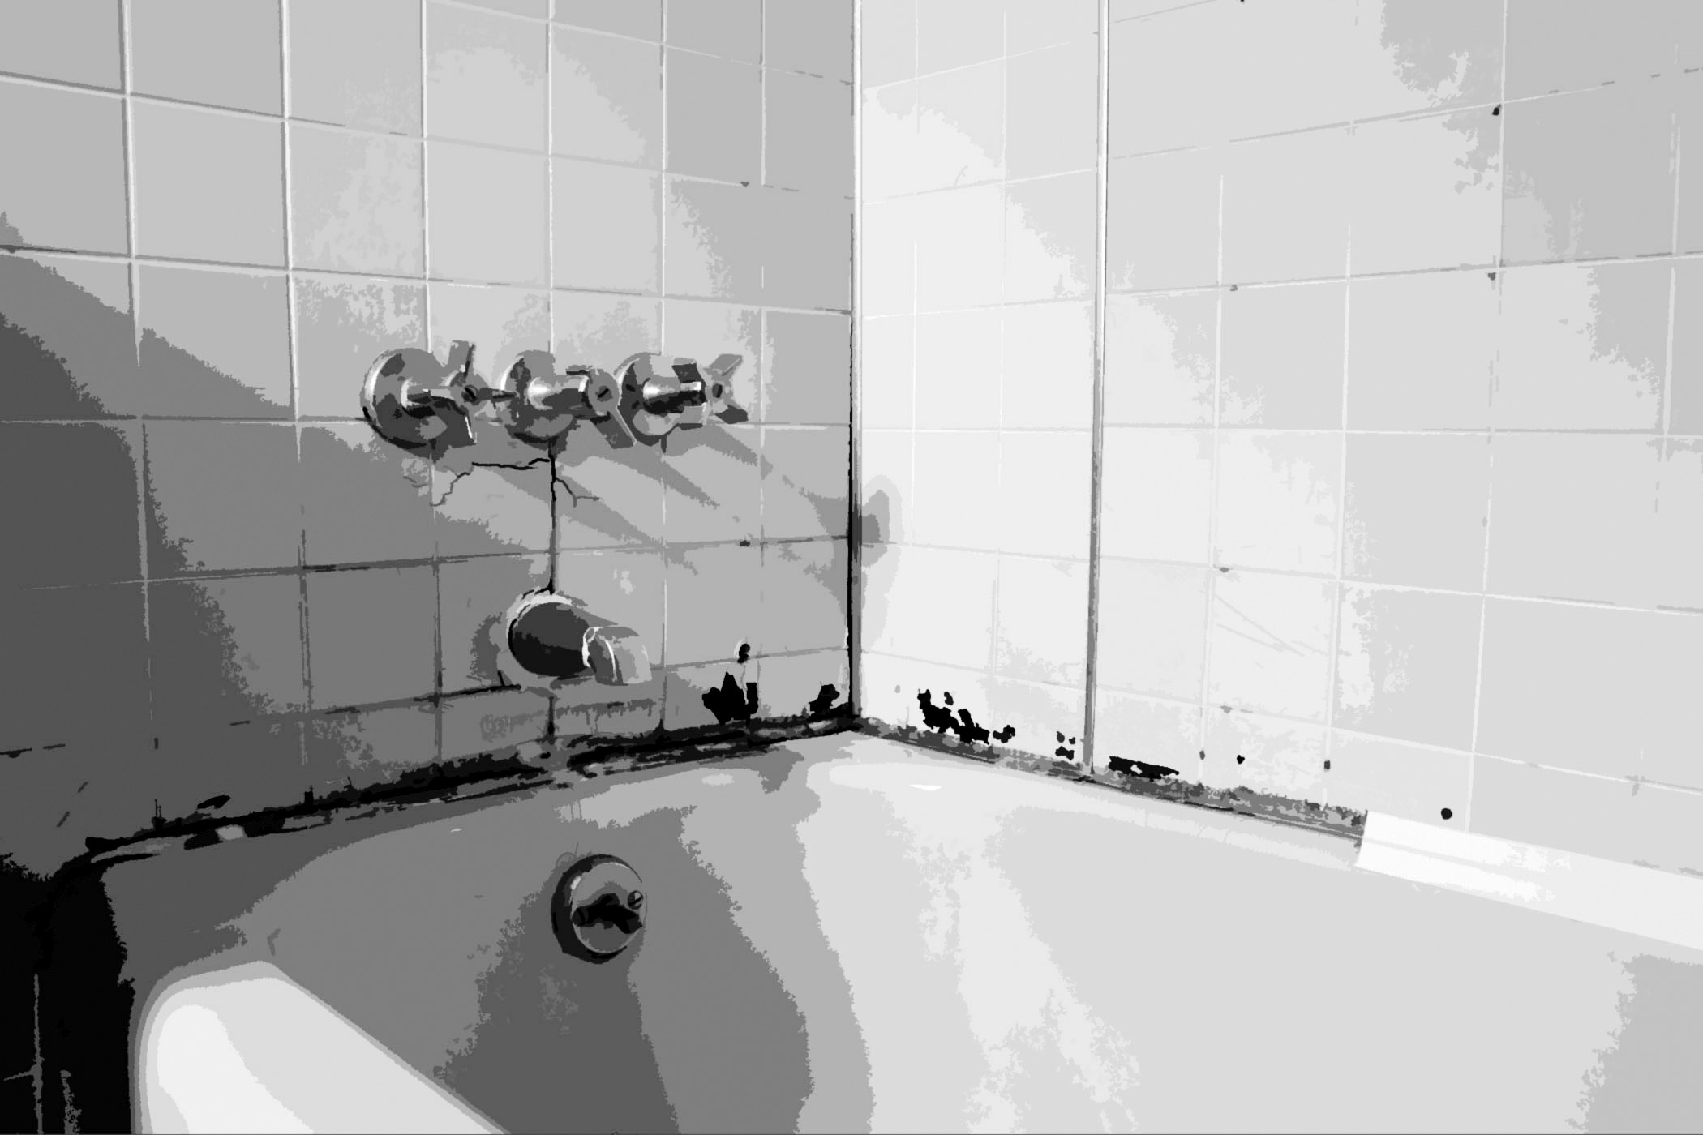
MOLD
Molds can grow both indoors and outdoors.
There is no exact seasonal pattern to mold that grows indoors. However, outdoor molds are seasonal. They first appear in early spring and can stay until the first frost.
Outdoor molds grow in wet areas in the shade and are found in soil, decaying plants, compost piles, rotting wood, and leaves.
Indoor molds are found in dark, warm, humid, and damp places like basements, cellars, attics, bathrooms, and laundry rooms.
Molds are also found where fresh food is kept. Indoor mold can also be in refrigerator drip trays, trash cans, air conditioners, and humidifiers.
Ways to prevent mold
Use a dehumidifier (a machine that helps take some of the water out of the air) or an air conditioner to keep the humidity below 50%.
Vent bathrooms and clothes dryers to the outside. Run bathroom and kitchen vent fans while bathing and cooking.
Check faucets, pipes, and ductwork (which are a group of pipes and vents used to move air through a room) for leaks.
When first turning on home or car air conditioners, leave the room or drive with the windows down for a few minutes. This will allow mold spores to go away.
Get rid of rotting leaves from the yard, roof, and gutters.
Avoid raking leaves, mowing lawns, or working with peat (a soil-like material that is brown in color, used for gardening). Avoid working with mulch, hay, or dead wood. If you must do yard work, wear a mask. Try to not work on hot, humid days.
Notes:
-Rachel
Flesh Kincaid score = 4.8

